Slide 1
ELECTRODIALYSIS REVERSAL DESALINATION

Slide 2
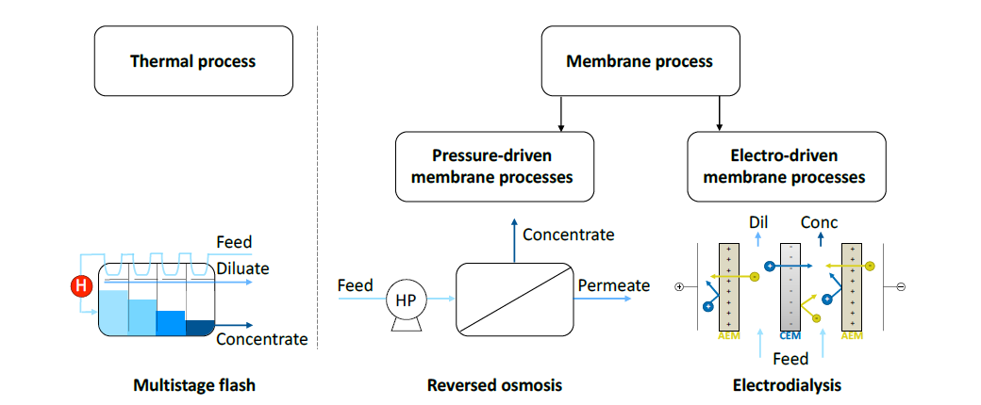
BACKGROUND SEAWATER DESALINATION
Fig 1: Schematic overview of thermal and membrane desalination processes

Slide 3


Slide 4
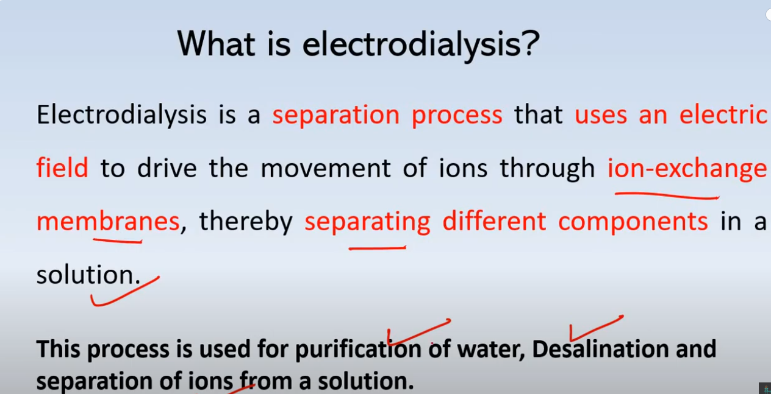

Slide 5
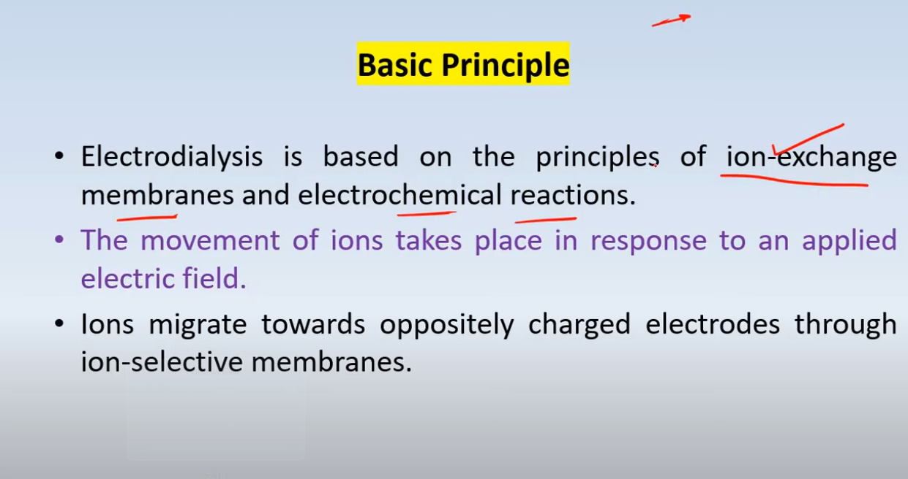

Slide 6
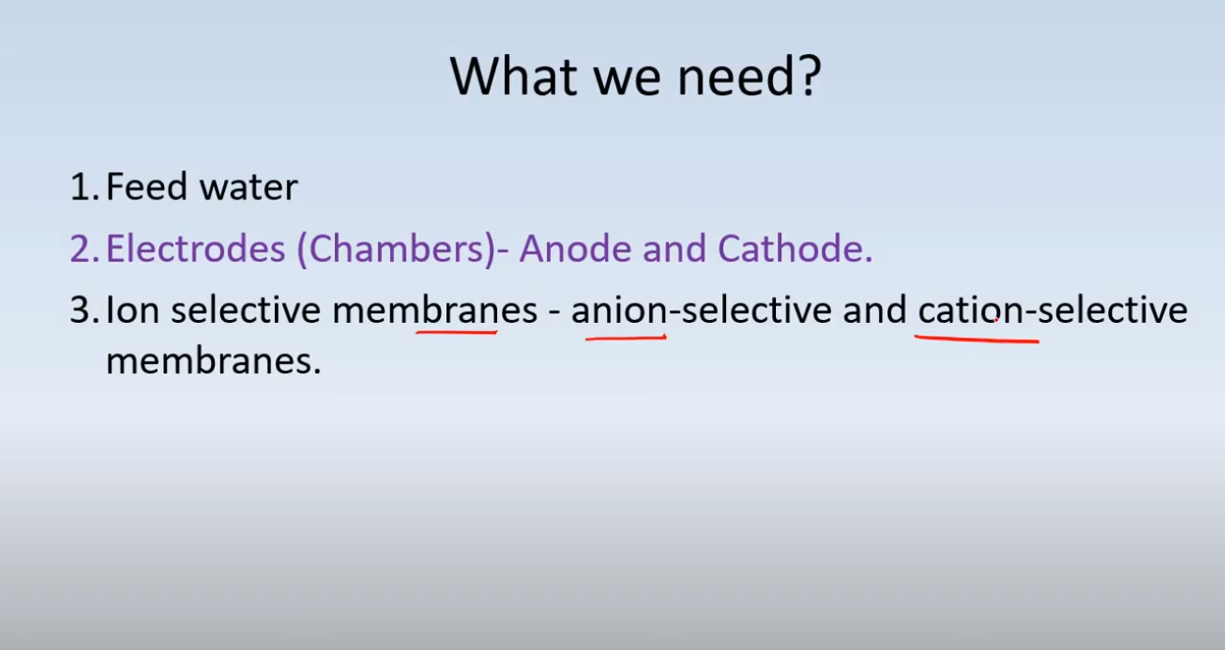

Slide 7
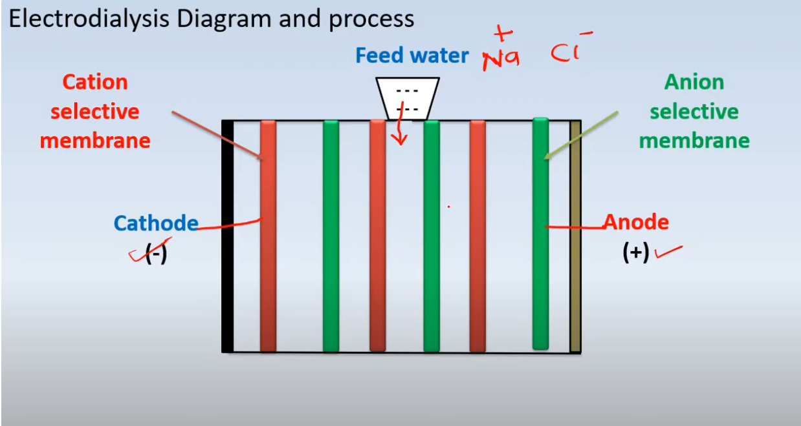
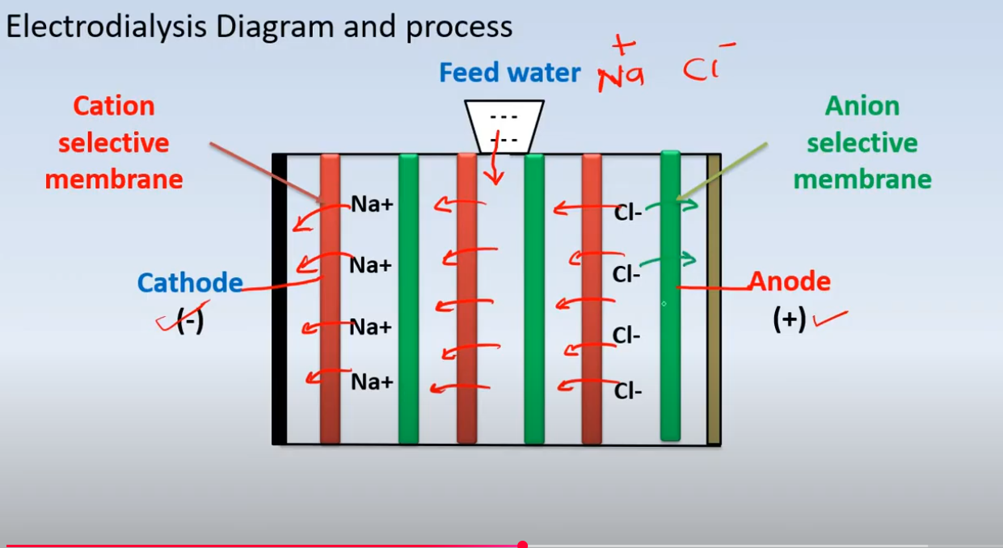

Slide 8
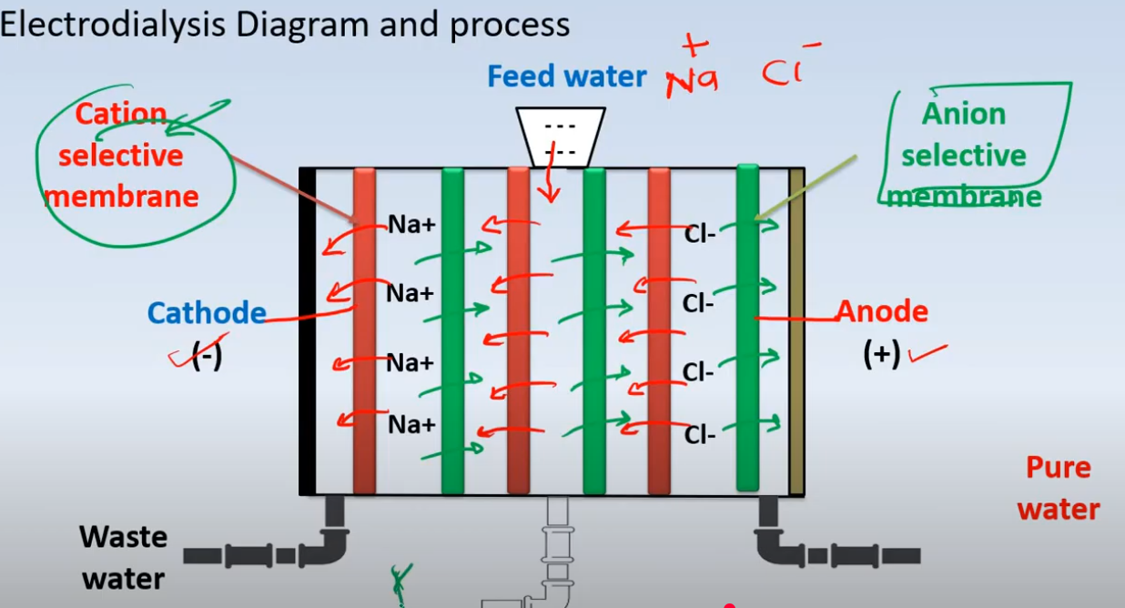

Slide 9
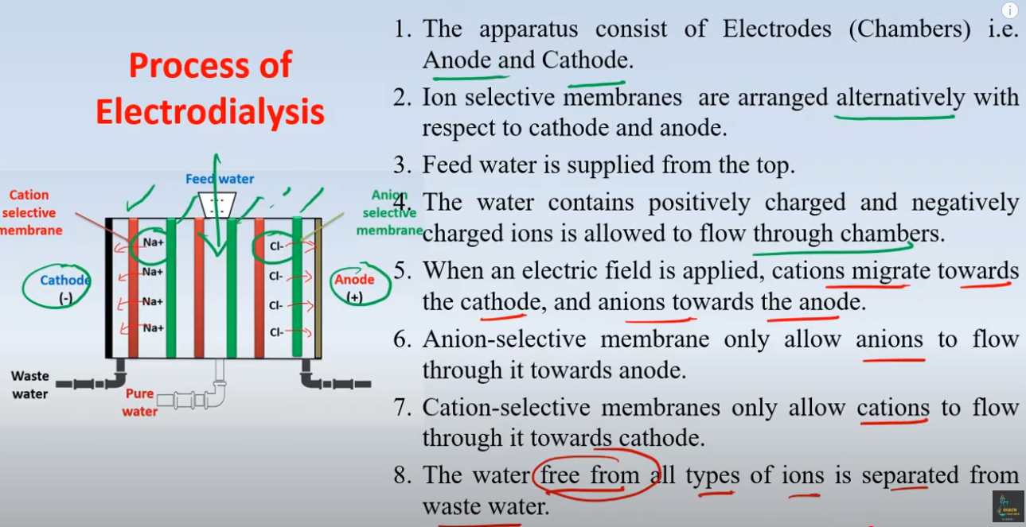

Slide 10
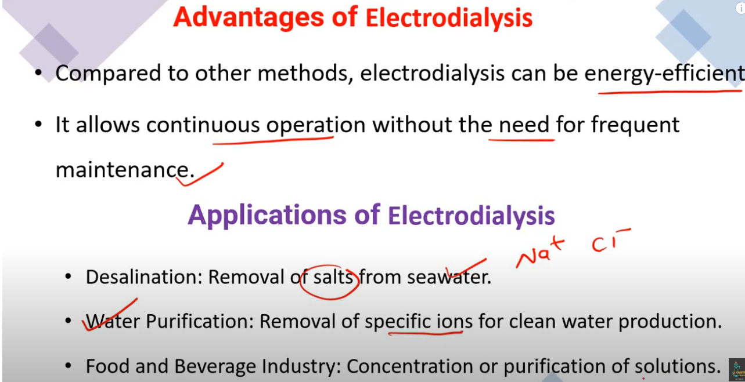

Slide 11
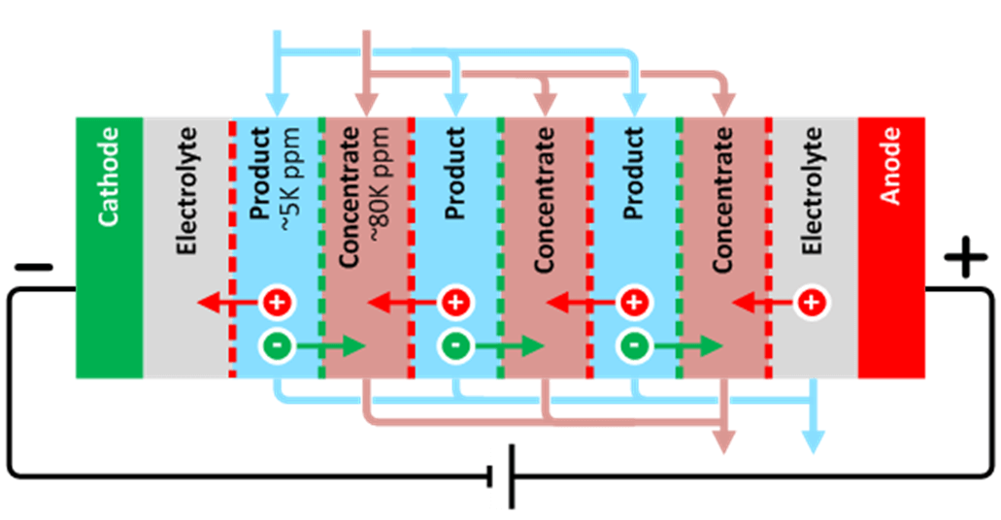
HOW DOES ELECTRODIALYSIS REVERSAL WORK?
Electrodialysis (ED) technology is the second most widely used membrane desalination technology and has been developed since the 1960s for a wide range of industrial applications. It involves applying a direct current (DC) electric field to flux positive ions across cation exchange membranes (CEM) in one direction, and negative ions through anion exchange membranes (AEM) in the opposite direction. The two types of membranes alternate within a stack (Figure 2).
Figure 2

Slide 12
As the process feedwater (or wastewater) enters the ‘product’ chamber, ions get pulled out of the product water as it travels up the length of the stack, parallel to the membranes.
These ions get concentrated up in the concentrate chamber, also flowing parallel to the product chamber, see Figure 2 below.
The ‘reversal’ term in EDR comes from recent innovation that allows the polarity of electrodes and hydraulic channels to ‘reverse’, which helps keep the membranes clean.
Typical electrodialysis systems are composed of stacks of cation and anion exchange membranes. However, due to recent advancements in membrane manufacturing, it is increasingly possible to selectively pull out monovalent ions using ion exchange membranes that have high divalent ion rejection (such as Saltworks’ IonFlux products with 98% divalent ion rejection). This monovalent electrodialysis reversal (mEDR) can be used for a number of treatment or reuse applications, including the following:

Slide 13
Removing chlorides to reduce corrosion in water circulating loops that result in high blowdown. A prime example of where this is particularly useful is in flue gas desulfurization wastewater, where the 90% recovered water can be recycled, while the final 10% residuals can be mixed with combustion ash or fly ash.
Removing scale-causing gypsum from cooling tower blowdown to enable higher cooling tower cycling, provided the tower is designed to handle the higher salinity, or if the corrosion-causing chlorides are removed.
Selectively removing sodium to reduce the sodium adsorption ratio (SAR) in agricultural or vertical farming wastewater to allow recycling of nutrients or multivalent fertilizer by-products.

Slide 14
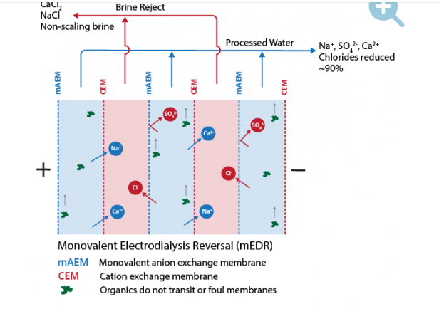
Fig 3 Monovalent electro dialysis reversal (MEDR process flow diagram

Slide 15
ELECTRODIALYSIS (ED) IS A MEMBRANE PROCESS
Electrodialysis (ED) is a membrane process in which ions are transported through ion exchange membranes under the influence of an electrical potential applied over a cathode and an anode (Figure 1.2).
Seawater flows through compartments formed between cation exchange membranes (CEMs) and anion exchange membranes (AEMs) that are alternately piled, and form repeating unit or cell pair, between the cathode and the anode.
Due to the applied electric field, cations migrate from one compartment through a CEM in the direction of the cathode to the next compartment, and simultaneously, anions migrate through an AEM in the direction of the anode.
The overall result is a membrane stack with compartments that alternately contain diluted and concentrated salt solutions, the so-called diluate and concentrate.
The electrode compartments at both ends of the membrane stack are rinsed with an electrolyte solution that enhances redox reactions and converts the electrical charge transport into ionic charge transport.
The cathode and anode are rinsed with the same solution and this may be e.g., a mixture of dissolved Fe2+ and Fe3+ salts

Slide 16
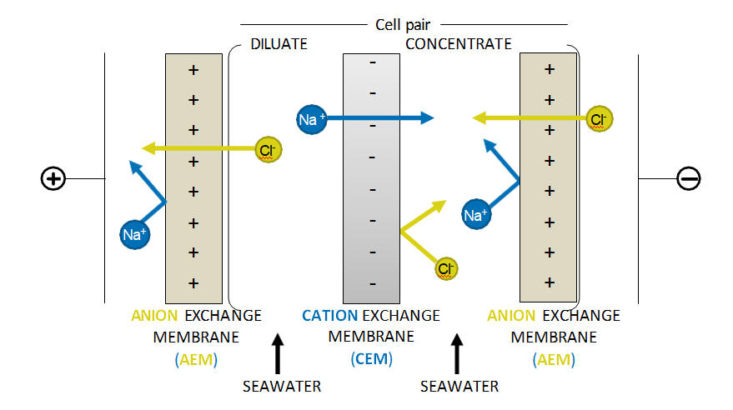
Fig 4 Schematic overview of an electrodialysis stack.
ED was developed about 70 years ago, but compared to RO it has not been widely used
for seawater desalination as it is considered too energy-intensive.

Slide 17
In ED the energy required to desalinate is proportional to the equivalent amount of salt that needs to be removed
To apply conventional ED in a cost-effective way for water desalination, the feed water concentration must range between 5 g/l to 10 g/l total dissolved solids
In that case a low current density is required. At higher feed water concentrations, where higher current densities are required, RO is more favorable in terms of energy consumption for desalination.
ED has the potential to be advantageous over RO because very little feed pre-treatment is required since membrane fouling is less persistent due to the absence of high trans membrane pressures and large water fluxes.
Besides, ED can achieve potentially higher brine concentrations than RO since there are no pressure limitations (to overcome the osmotic pressure difference over the membrane). The chemical and mechanical stability of ion-exchange membranes enables longer membrane lifetimes even when using feed waters with aggressive and oxidizing components

Slide 18
CHALLENGES IN ELECTRODIALYSIS FOR SEAWATER DESALINATION
ED systems suffer from high energy consumption because a major part of the inefficiency of ED desalination can be attributed to the changing conditions along the stack in terms of increasing internal transport resistance (mainly due to decreasing conductance in the diluate compartments).
Additionally, the contribution of increasing back forces, such as back diffusion of ions, plays an essential role in the inefficiency due to the increasing concentration gradient over the membranes (Figure 1.3).
When a voltage or a constant electrical current is applied on the electrodes, these changing conditions result in a maldistribution of ionic currents in the stack.
This maldistribution is enhanced even further when ions become depleted at the membrane interface of the diluate compartments.

Slide 19
This occurs when at certain positions in the ED stack the limiting current density (LCD) is exceeded.
LCD conditions are the result of a salt depleted diffusion boundary layer (DBL) that develops in the diluate compartment at the membrane interface (Figure 1.3), also referred to as concentration polarization.
LCD conditions arise in ED because of low ion transport numbers in solutions compared to the ion transport numbersin membranes .
Concentration polarization is induced by a high driving force,poor mixing in the diluate compartments and membranes with high ion transfer

Slide 20
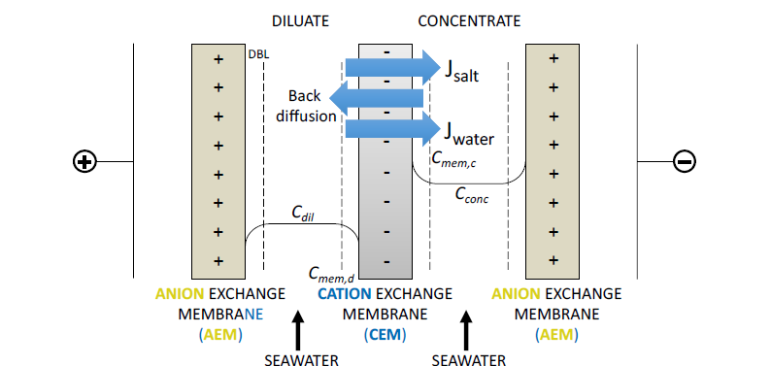
Figure 1.3: Schematic overview of an electrodialysis stack with indications of transport mechanisms, Jsalt indicating ion transport, back diffusion of ions, and Jwater indication the direction of water transport. Diffusion boundary layer (DBL) indicates the low salt concentration or salt depleted boundary layers (Cmem,d, Cmem,c, for respectively diluate and concentrate) that build up during the desalination process

Slide 21
Reference:
1. https://www.saltworkstech.com/articles/what-is-electrodialysis-reversal-and-its-new-innovations/
2.efaidnbmnnnibpcajpcglclefindmkaj/https://research.tue.nl/files/164890905/20201217_Doornbusch.pdf2.

